Slide 1
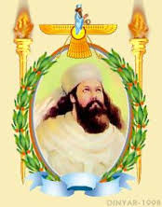
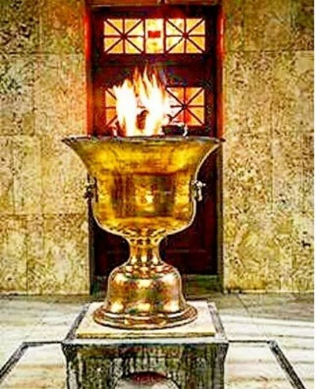
ZAH NoRouz Celebration
SATURDAY MARCH 26, 2022 at ZAH CENTER
ZAH Center Doors Open at 7:30 p.m.
INSERT RSVP LINK HERE
There will be no boxed meals to go. Only guests present will have meals served. Left overs (if any) will be sold once all guests have eaten. Thank you.
For questions
please contact:
Arzin Italia (713) 679-4998
DJ Music
Dance the Night Away
Elaborate Menu Catered From Savoy Restaurant
BYOB
RATES: (Under 3 yrs. Gratis) RSVP Deadline 3/20/22
ZAH Member : 11 years and up - $40**
ZAH Non-Member : 11 years and up - $55
Member Children (KG – 5th grade) : 20**
Non- Member Children (KG – 5th grade) : $25
If paying by check, your check must be received by 3/20/22, at:
ZAH
Attn: NoRouz 2022
8787 West Airport Blvd
Houston, Texas 77071
PLEASE WRITE (IN THE MEMO FIELD):
- No. of ZAH members/non-members (11 yrs and up)
- No. of ZAH member/non-member children (KG – 5th Grade)
- Please write “NoRouz 2022” on the envelope
NO RSVP’s EFFECTIVE 3/21/22
AT THE DOOR: $55 PER PERSON
** Membership rate applies if 2022 membership have been paid. Kids over 18 years must have separate membership from their parents
- Member rates apply to out-of-town house-guests of members (if online RSVP, online payment, and check (if applicable) is received by 3/20/22)
- Our goal remains to keep these functions as affordable as possible so you as a ZAH member can attend and enjoy. However if you feel that you are unable to attend solely due to the cost please let us know. We have donations in place to subsidize your cost and we will guarantee confidentiality. Financial ups and downs are a part of most families life cycles. In a way, they are a blessing because they allow innovation, dedication and hard work to take root in oneself. Please use this facility and in better economic times, there will be plenty of opportunities to remember and help your own community members and your own association a thousand times over.
Please note this is only available to current ZAH Members in good standing.
Organized by: ZAH Entertainment Committee

